Slide 1
Upgrading Apollo’s Chore System
Mark Endicott

Slide 2
Current Chore System:
Relies on pictures, word-of-mouth, and a designated task master for communication and enforcement.
Members select any 4 dish-days of the month, depending on the meal plan, and bathrooms are assigned to everyone 1-2 times a month.
Includes weekly bounties to encourage participation and incrementing fines for missed chores, with additional credits for initiative.
Officers are exempt from the regular chore rotation, and chores are assigned regularly.
Advantages:
Allows for chore flexibility for both members and officers.
Works well enough to have a relatively clean house with minimal effort.
Problems:
Limited incentives and potential for inequitable officer rewards.
Inconsistent and inaccurate reflection of individual contributions.
Dishes and bathroom cleaning are often neglected.
Current system may not effectively incentivize consistent chore completion.

Slide 3
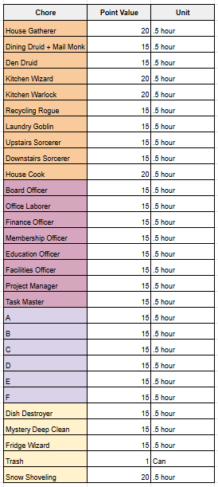
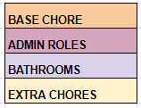
Time-Based Point System
1 point = 1 dollar. Yippee!
For every 1 point over 35 per week, that’s 1 credit to that member.
Fined for not doing base chores.
We can now measure big and small contributions accurately by time.
Example: Say I do finance chores, bathrooms, and dish in one week. Each 30 minutes. That’s $10 extra for that week!
Anything on top of that is more money. This applies to everyone!

Slide 4
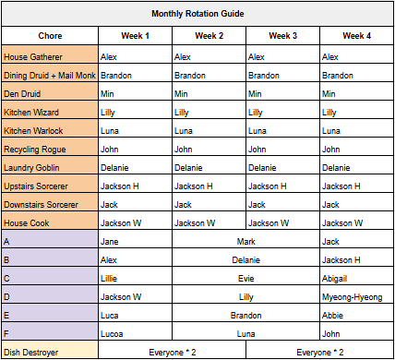
One Month:
Main (60 pts) - 2 hours
Bathroom (15 pts) - .5 hour
Dish (60 pts) - 2 hours
135 / 4 = 33.75 pts a week
Encourages someone to pick up an extra chore!

Slide 5
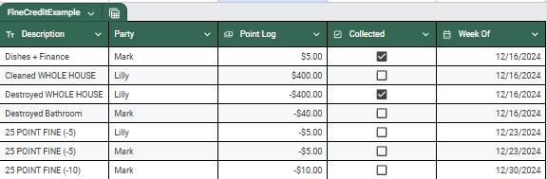
Handling Fines/Credits:
Totals will be summed at the end of the month (minus 25 x 4)
If you consistently miss the weekly 35 threshold, -5 points for each additional week missed in a row.
Example: Missed week 1, -5 points. Missed week 2, -10 points, Missed week 3, -15 points.
This would go up to -30 points every week (transfers month to month).

Slide 6
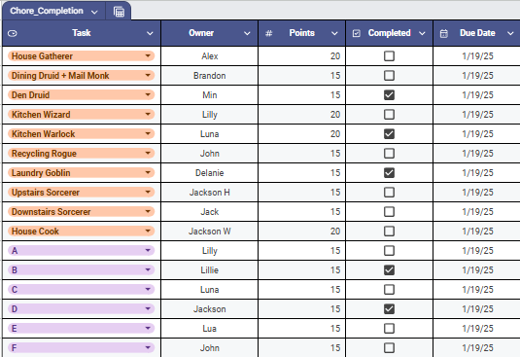
Handling Bounties
Chores that are not completed will be posted.
Bounty collectors may receive those points + 5 points. Wa-hoo!

Slide 7


Point Collection
Options:
Discord thread for chore recording (with feet pictures).
DM taskmaster (with feet pictures).
Pinned spreadsheet for everyone to enter their points.
May require an inspector.
Should be paired with discord pictures/records.
Easier on taskmaster.
Of course, members will be fined if they do not communicate their points!

Slide 8
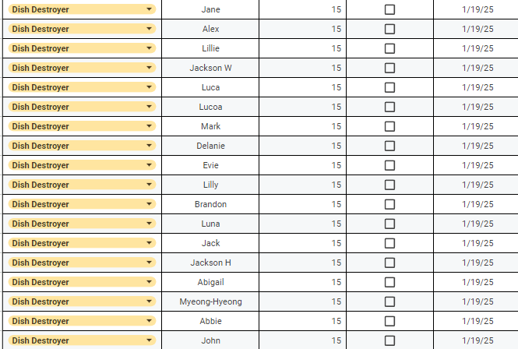
Dish Management
My proposal:
15 points worth of dishes for every member, every 2 weeks.
Still flexible but avoids dumping all the labor into one week.
Also collected through pictures and discord.
DOES NOT NEED THE CALENDAR → LESS CHAOS.
Fined 15 if caught leaving more than a tub of dishes out for more than 2 days!
WOMP WOMP!
Next deadline → 2/4/25

Slide 9
LETS APPROVE/DISCUSS.
ANY QUESTIONS? MINOR CHANGES? MAJOR CHANGES?

Slide 10
Prepared Responses
What if I complete my chore under 30 min?
Pick up another chore from a list of chores.
How long until I can do the same chore again?
Depends on how much needs to be done - case by case.

